Slide 1
Visual Analytics– Coordinated Multiple Views
Dr. Ab Mosca (they/them)
Slides based off slides courtesy of Jordan Crouser (https://jcrouser.github.io/)

Slide 2
Plan for Today
Interaction as context-preserver
Coordinated multiple views (CMV)
Brushing and linking
Demo: plotly

Slide 3
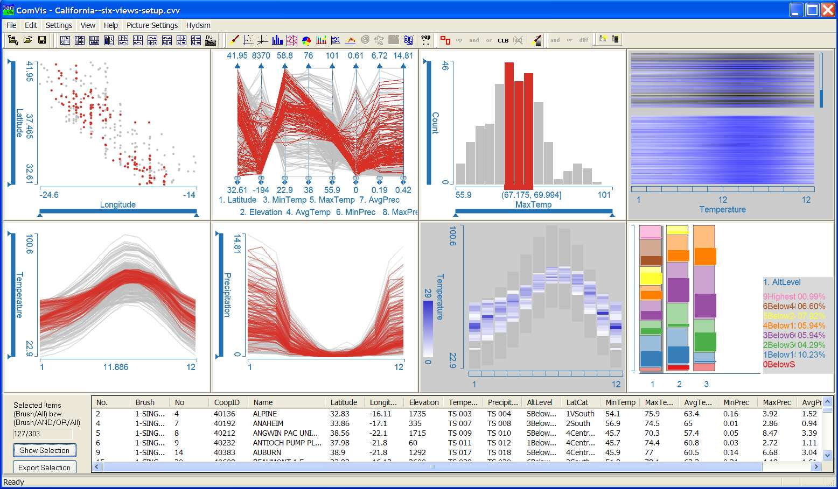
Show me related items: coordinated multiple views (CMV)
Recap:
7. Connect

Slide 4
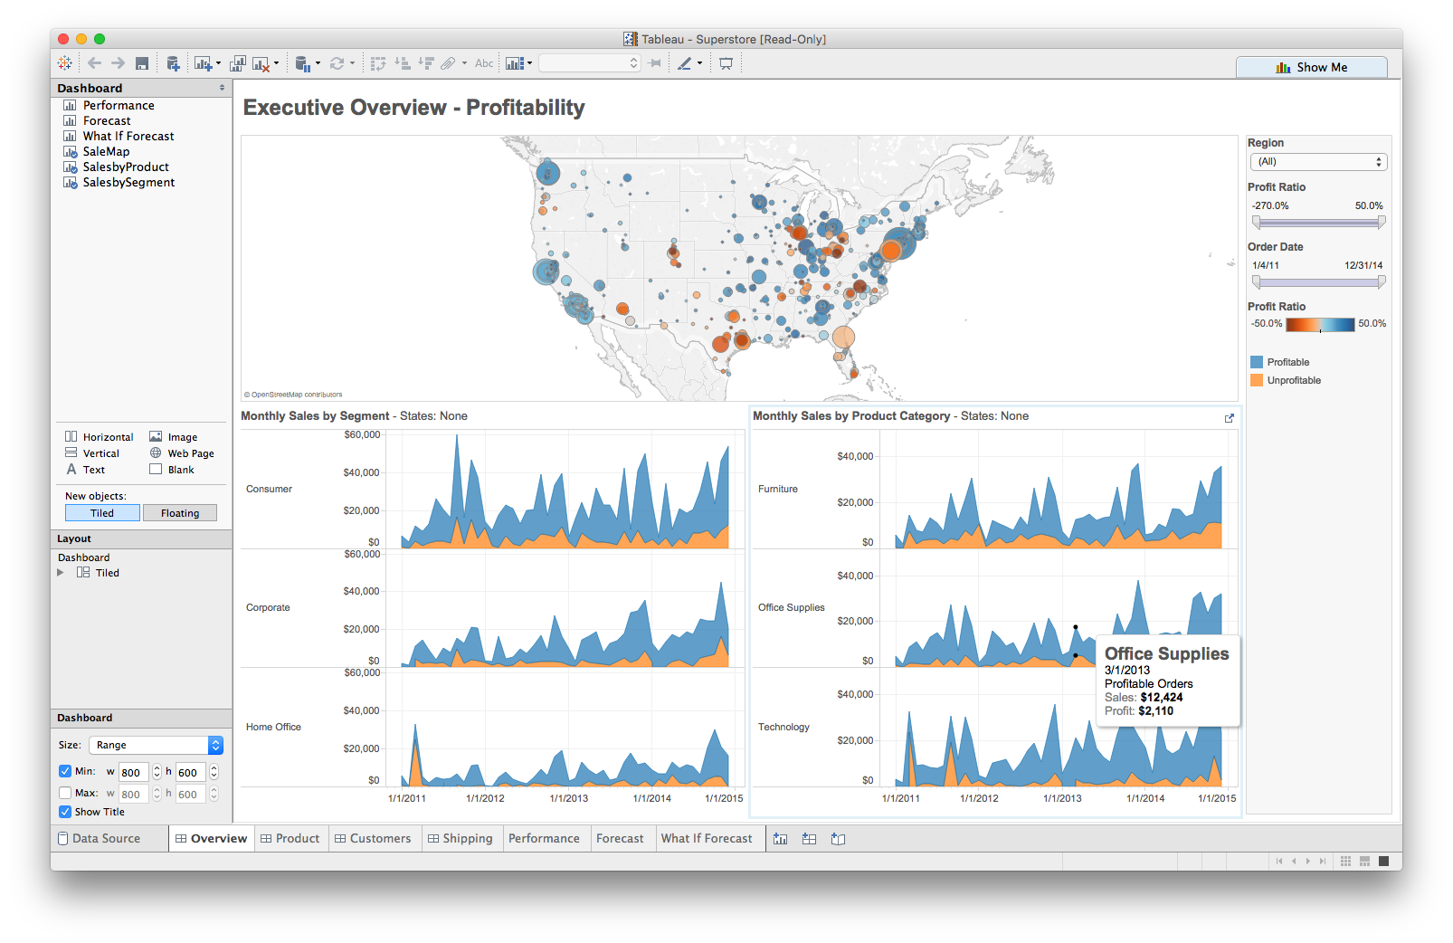
Multiple views
Different
representations
Different
data
Systems that use two or more distinct views
to support the exploration of a single concept or domain

Slide 5
When to use multiple views?
The data is too big
Lots of attributes
Lots of observations
The data is too complicated
Lots of data sources
Lots of data types
The data has several interesting parts, but no one visualization highlights them all

Slide 6
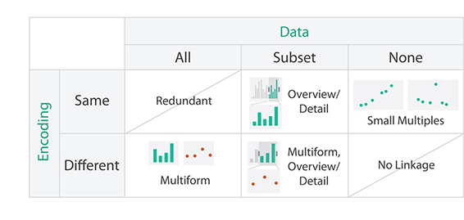
Multiple View Designs

Slide 7

Multiple View Designs

Slide 8
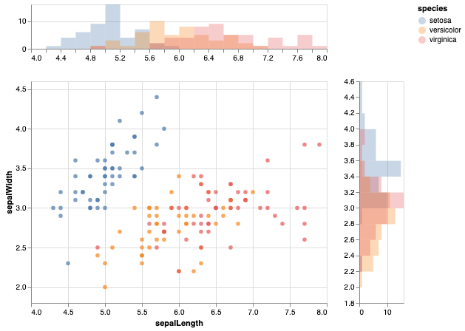
Multiple View Designs: Multiform
https://altair-viz.github.io/gallery/scatter_marginal_hist.html

Slide 9
Multiple View Designs

Slide 10
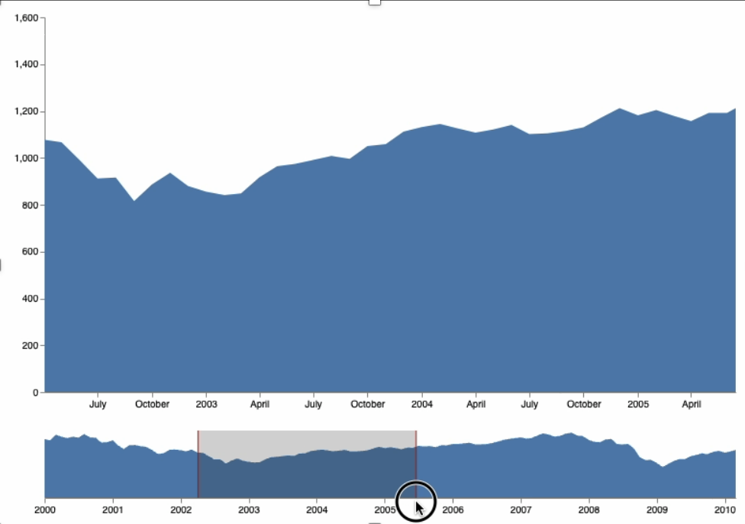
Multiple View Designs: Overview / Detail
https://vega.github.io/vega/examples/overview-plus-detail/

Slide 11
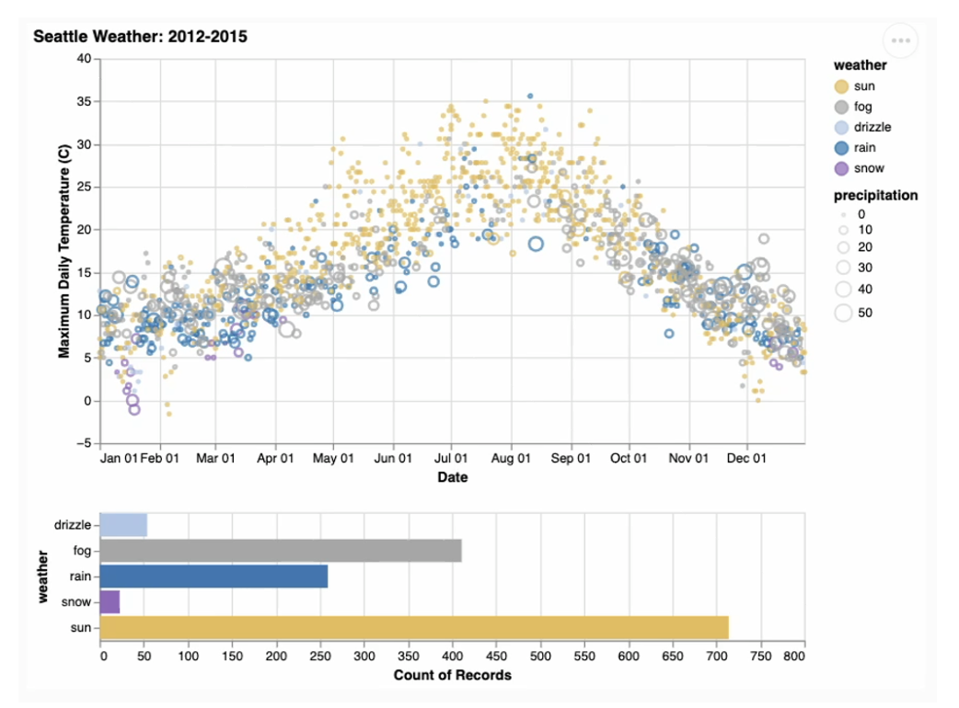
Multiple View Designs: Multiform Overview / Detail
https://altair-viz.github.io/gallery/seattle_weather_interactive.html

Slide 12
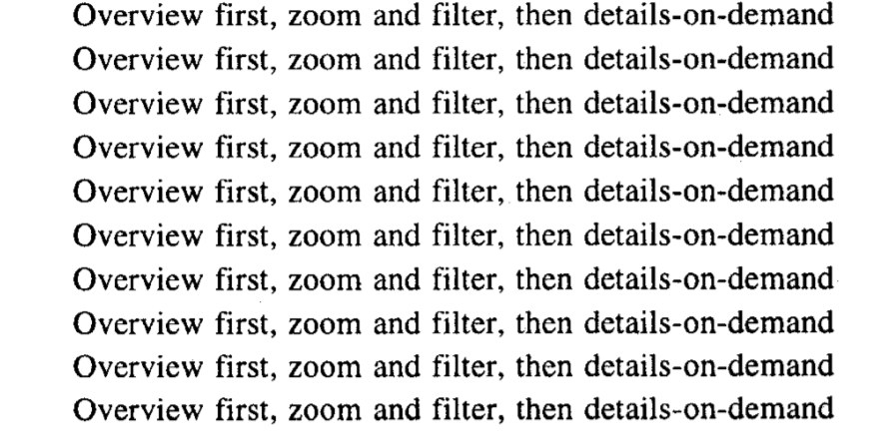
Also called Filter + Context Designs
Overview / Detail
- Ben Shneiderman

Slide 13
Multiple View Designs

Slide 14
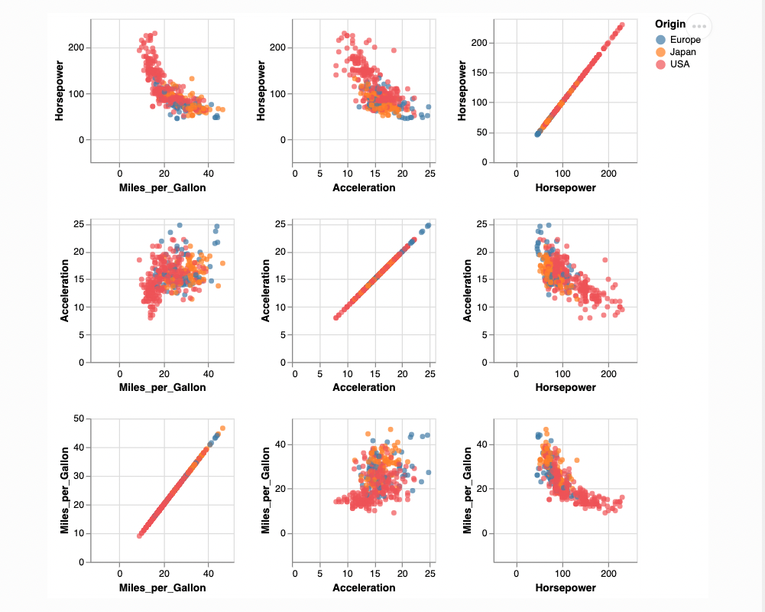
Multiple View Designs: Small Multiples
https://altair-viz.github.io/gallery/scatter_matrix.html

Slide 15
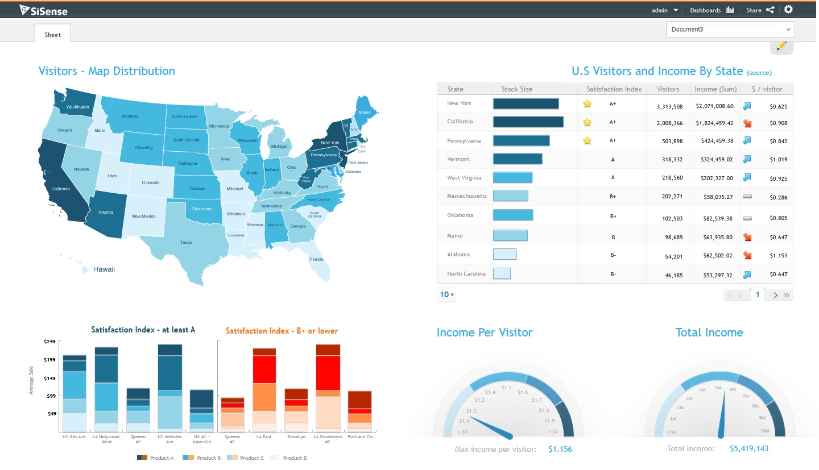
Need to think about: resource optimization

Slide 16
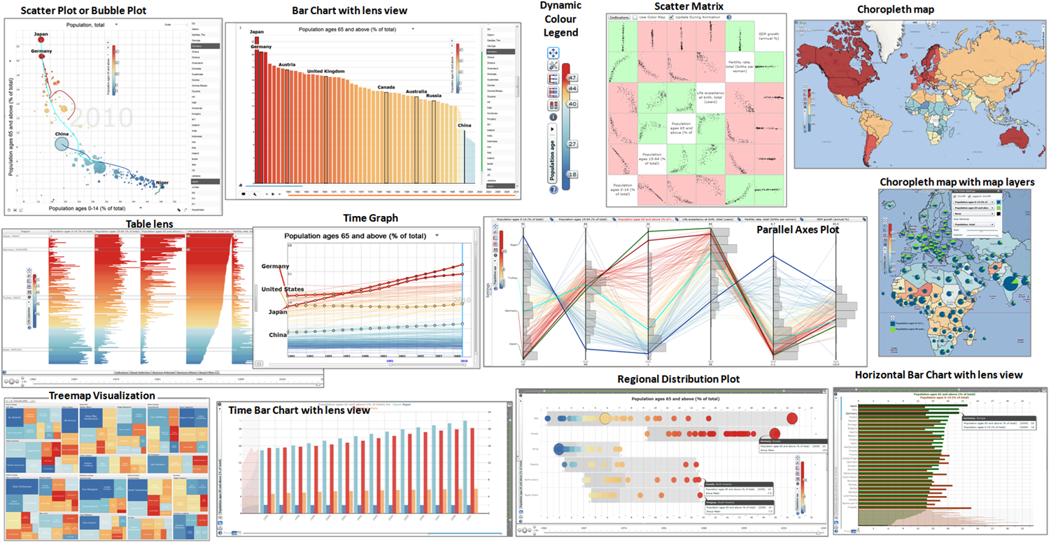
Need to think about: resource optimization

Slide 17
Balance the costs of presenting multiple views with the benefits of using the views
Split complex data into multiple views to create manageable chunks
Use views that are complimentary, bringing out correlations and/or disparities
Use perceptual cues to:
make relationships more apparent to the reader
focus the reader’s attention on the right view at the right time
Guidelines for multiple views

Slide 18
Coordination: brushing and linking
Big idea: actions in the real world have ripple effects; actions on a visualization should too
Brushing: the visualization responds (usually through highlighting) as a person “brushes past” data points
Linking: the visualization connects related data points across multiple views

Slide 19
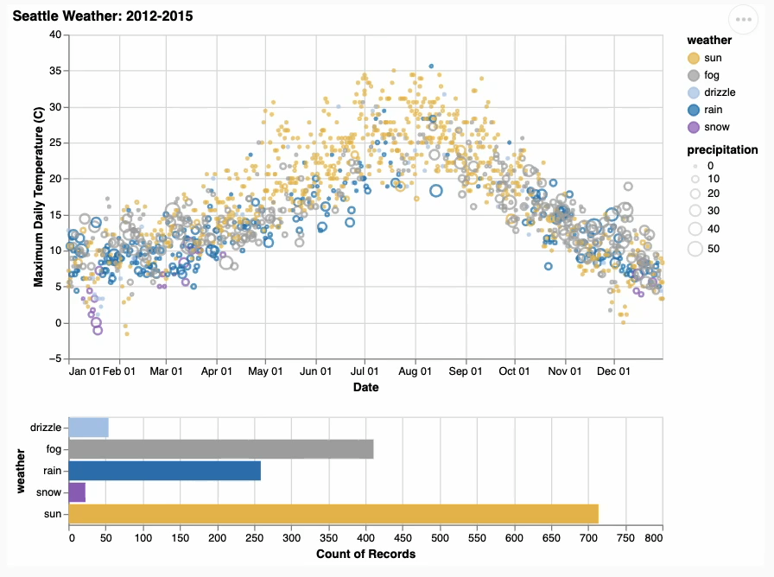
Coordination: brushing and linking
https://altair-viz.github.io/gallery/seattle_weather_interactive.html

Slide 20
Multiple views + brushing and linking
Big idea: propagate interaction from one view to all others, respond as appropriate
Coordinated multiple views

Slide 21
Practice
Find a partner and work through the R or Python coordinated multiple views demo on the class website

